Slide 1

PROFESSIONAL COMMUNICATION
COMPUTER SCIENCE IN MEDICINE
Presented by,
Anu Mathew
S2 CSE A
Roll No:16
28/5/2021

Slide 2

CONTENTS
Telemedicine
Electronic Medical Records
Medical Informatics
Medical Imaging
Computer assisted Surgery
AI in Cancer Treatment
AI in Depression Treatment
VR in Healthcare
Conclusion
References

Slide 3








TELEMEDICINE
Healing from a distance.
Real- time video communication.
Reduce the extra strain to travel
Reduce cost of treatment
Remote patient monitoring
Consist of telemedicine platform , telemedicine software and communication media
Store and forward

Slide 4

ELECTRONIC MEDICAL RECORDS(EMR)
Complete documentation of each patient.
Secure and confidential method of keeping records.
Tracking patients needed follow up.
Improved patient care.

Slide 5

MEDICAL INFORMATICS
Connect people ,technology and data.
Data analysis in medicine
Organise and manage information.
Easier and quicker access to patient histories.
Predict trends in illness, outbreaks and treatment.

Slide 6
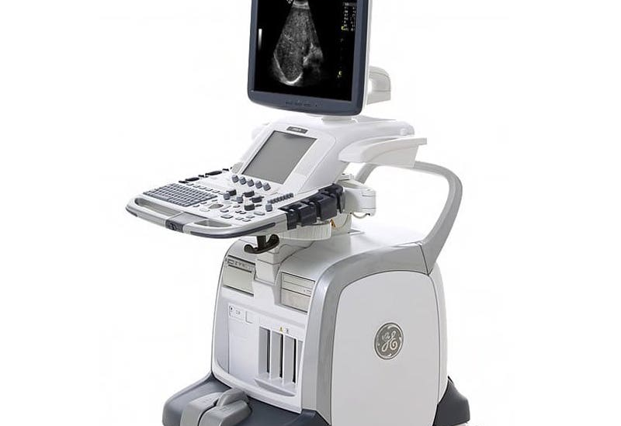
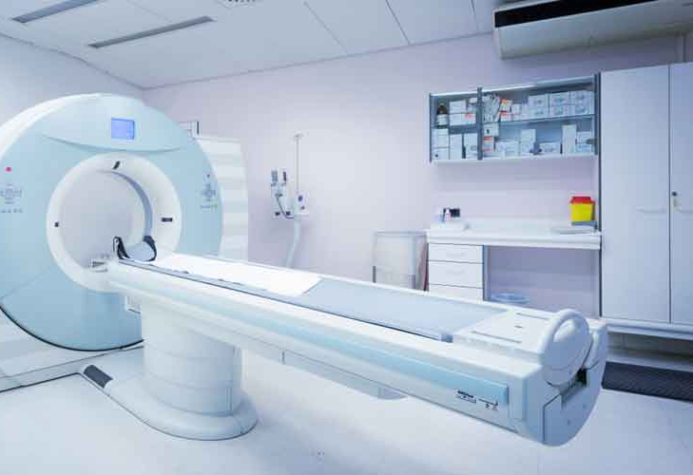
MEDICAL IMAGING
3 –D images of internal organs.
High resolution image generation.
Infrared cameras and sophisticated computers are used
CT scan, MRI, Ultrasound scanning

Slide 7
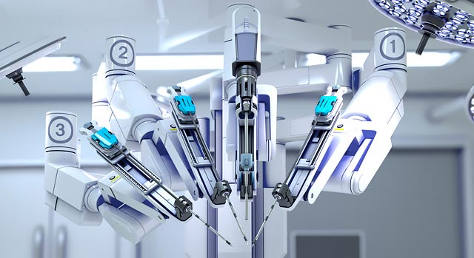
COMPUTER ASSISTED SURGERY
Da Vinci surgical robot
More precise.
Smaller incision require
Faster procedure
Less recovery time.
Increased rotation and dexterity
Fewer risk of complications

Slide 8
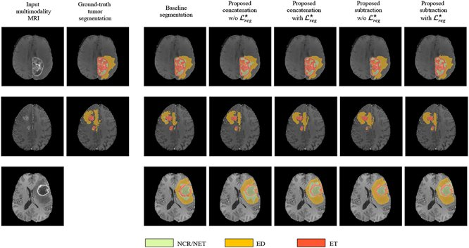
AI IN CANCER TREATMENT
Using machine learning and natural language processing
More precise
Early detection
ML techniques
  ANNs, BNs, SVMs, DTs
Languages used
    Python , MATLAB, Java, JavaScript , etc.

Slide 9
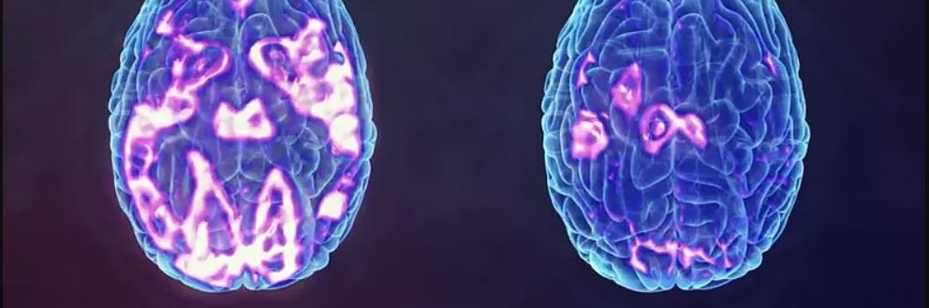
AI IN DEPERSSION TREATMENT
Predict anti- depressant based on brain activity
Machine learning algorithm to analyse and use EEG data to predict
Accurate
More effective

Slide 10
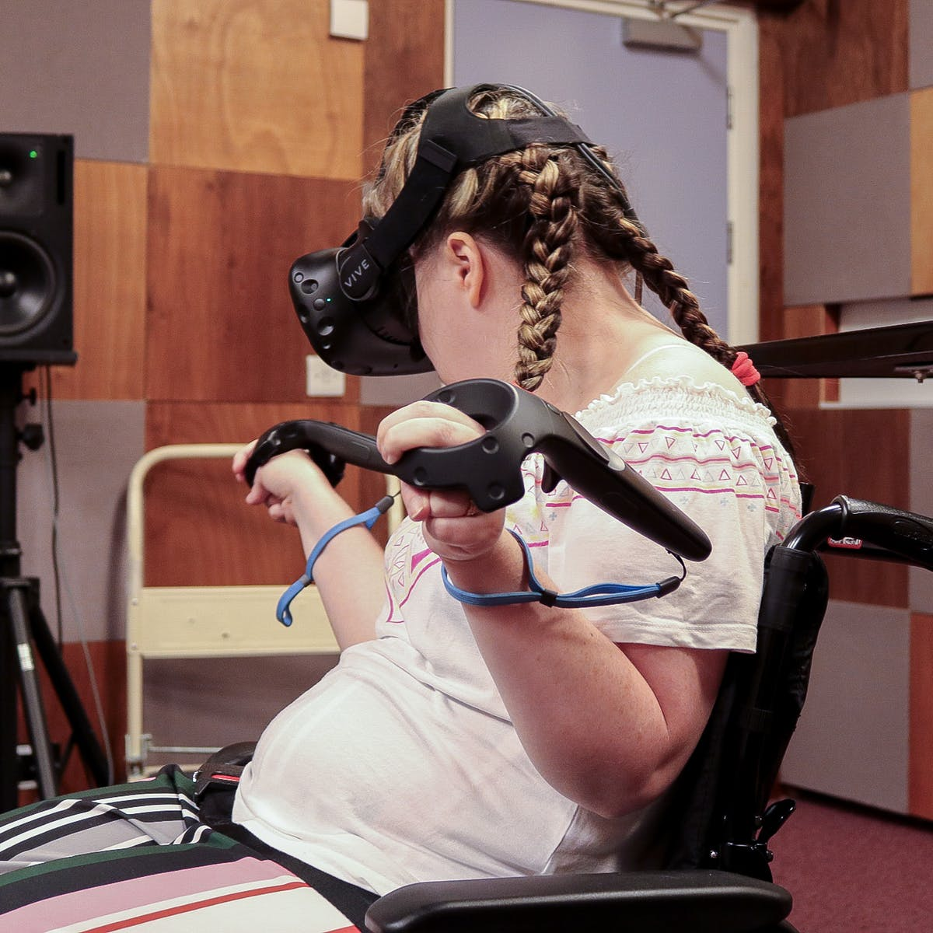
AI FOR DISABLED
Greater mobility of prosthetics
Computer assisted therapy
Communication, accessibility and independent living
Voice assisted AI technology
  Alexa, Echo, or Smartphone
Speech- to- text and Text- to –speech technology

Slide 11
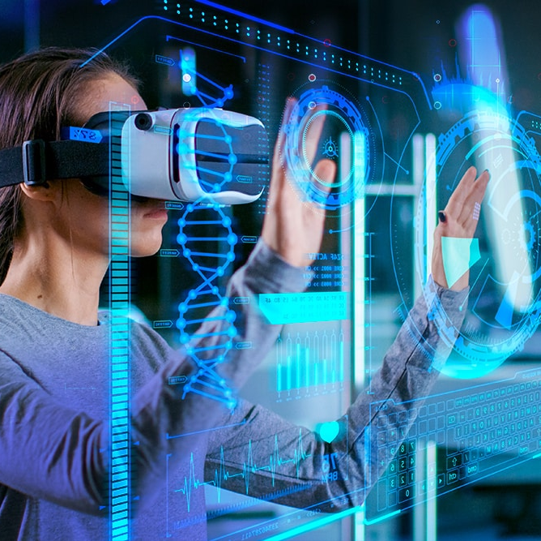
VR IN HEALTHCARE
Medical training
Patient education
Pain management and physical therapy
Mental health and psychological therapy
Disease awareness
VR in surgery
Autism treatment

Slide 12

CONCLUSION
More precise diagnosis and treatment
Improved patient care
Revolutionized medicine
Better understanding about diseases
Personalized treatment
Time saving
Less trauma for body

Slide 13

REFERANCE
Wikipedia
https://industrywired.com
https://www.biomedcentral.com
https://theconversation.com/
https://harvardpublichealthreview.org/

Slide 14

Any Queries?

